Slide 1
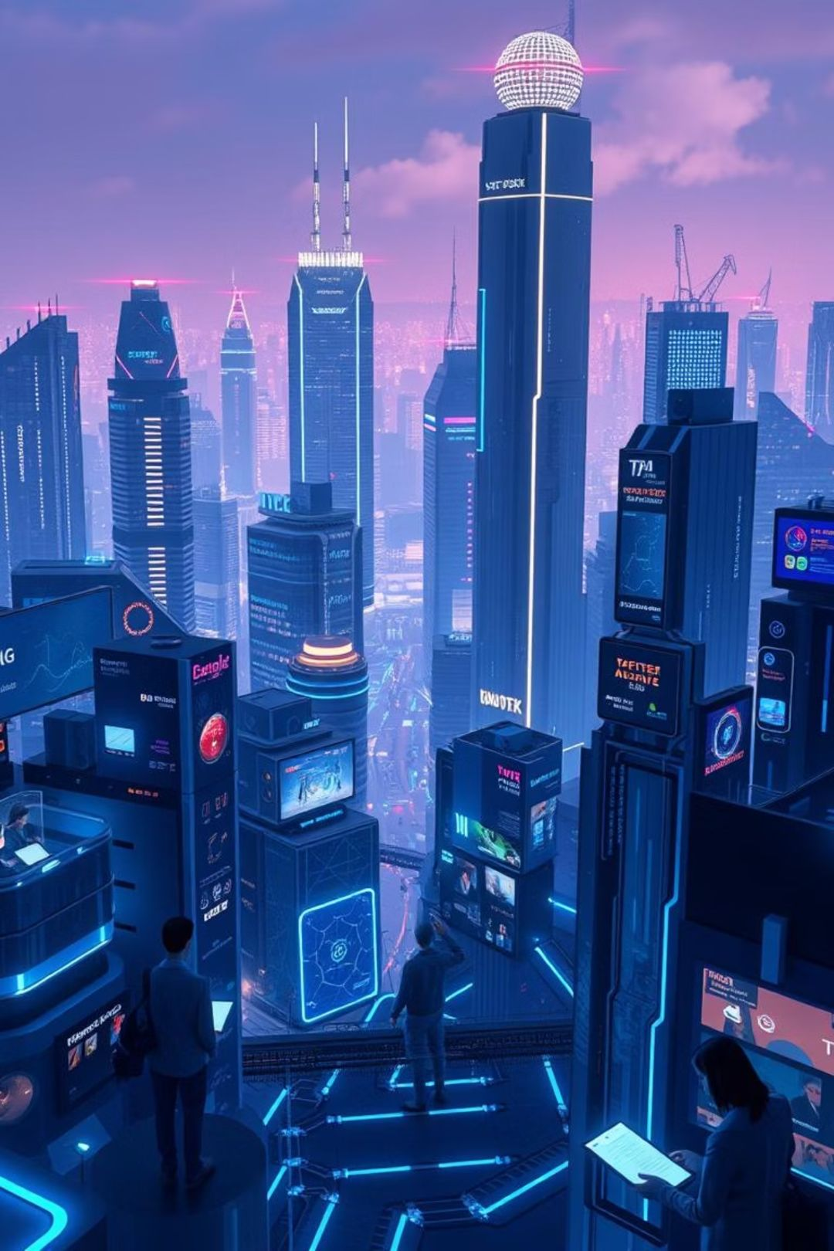
Artificial Intelligence: Today's Reality
It's not just the future; it's already shaping our world.

Slide 2
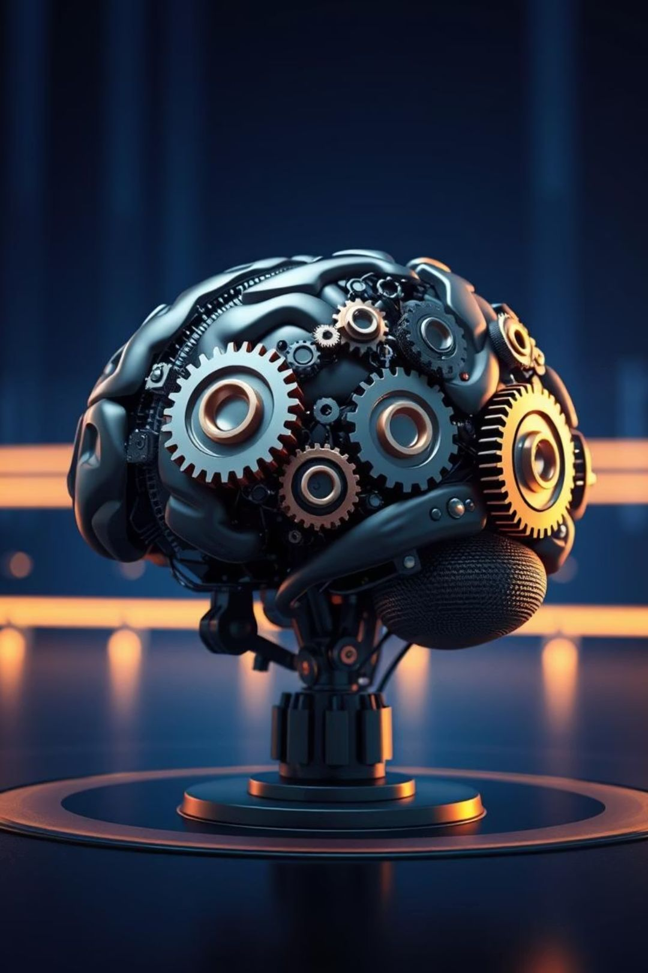
Understanding Artificial Intelligence
At its core, Artificial Intelligence (AI) is about creating machines that can think, learn, and solve problems like humans.
Simulating Human Intellect
From complex calculations to creative endeavors, AI aims to replicate human cognitive functions.
Learning from Data
AI systems continuously improve their performance by analyzing vast amounts of information.

Slide 3


The World of Machine Learning
Machine Learning (ML) is a powerful subset of AI. It empowers computers to learn from data without explicit programming.
Data-Driven Insights
Continuous Improvement
Forecasting the Future
ML algorithms find patterns and make predictions from existing data.
The more data they process, the smarter ML systems become.
From stock markets to weather, ML helps us anticipate what's next.

Slide 4
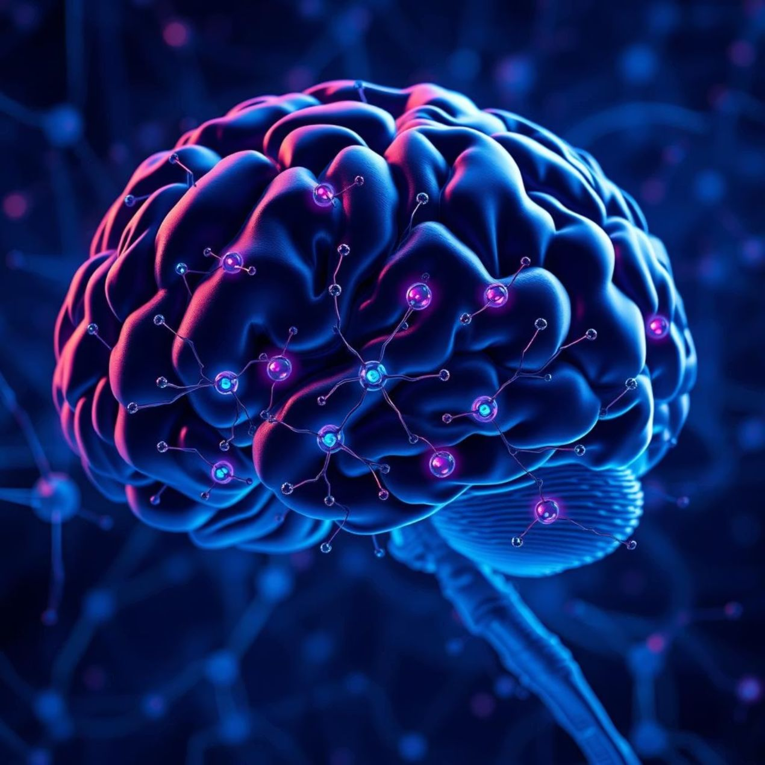
Deep Learning: The Next Frontier
Deep Learning (DL) is a specialized form of Machine Learning inspired by the human brain's neural networks.
It uses multi-layered neural networks to learn intricate patterns from massive datasets.
Image Recognition
Natural Language Processing
Autonomous Systems

Slide 5
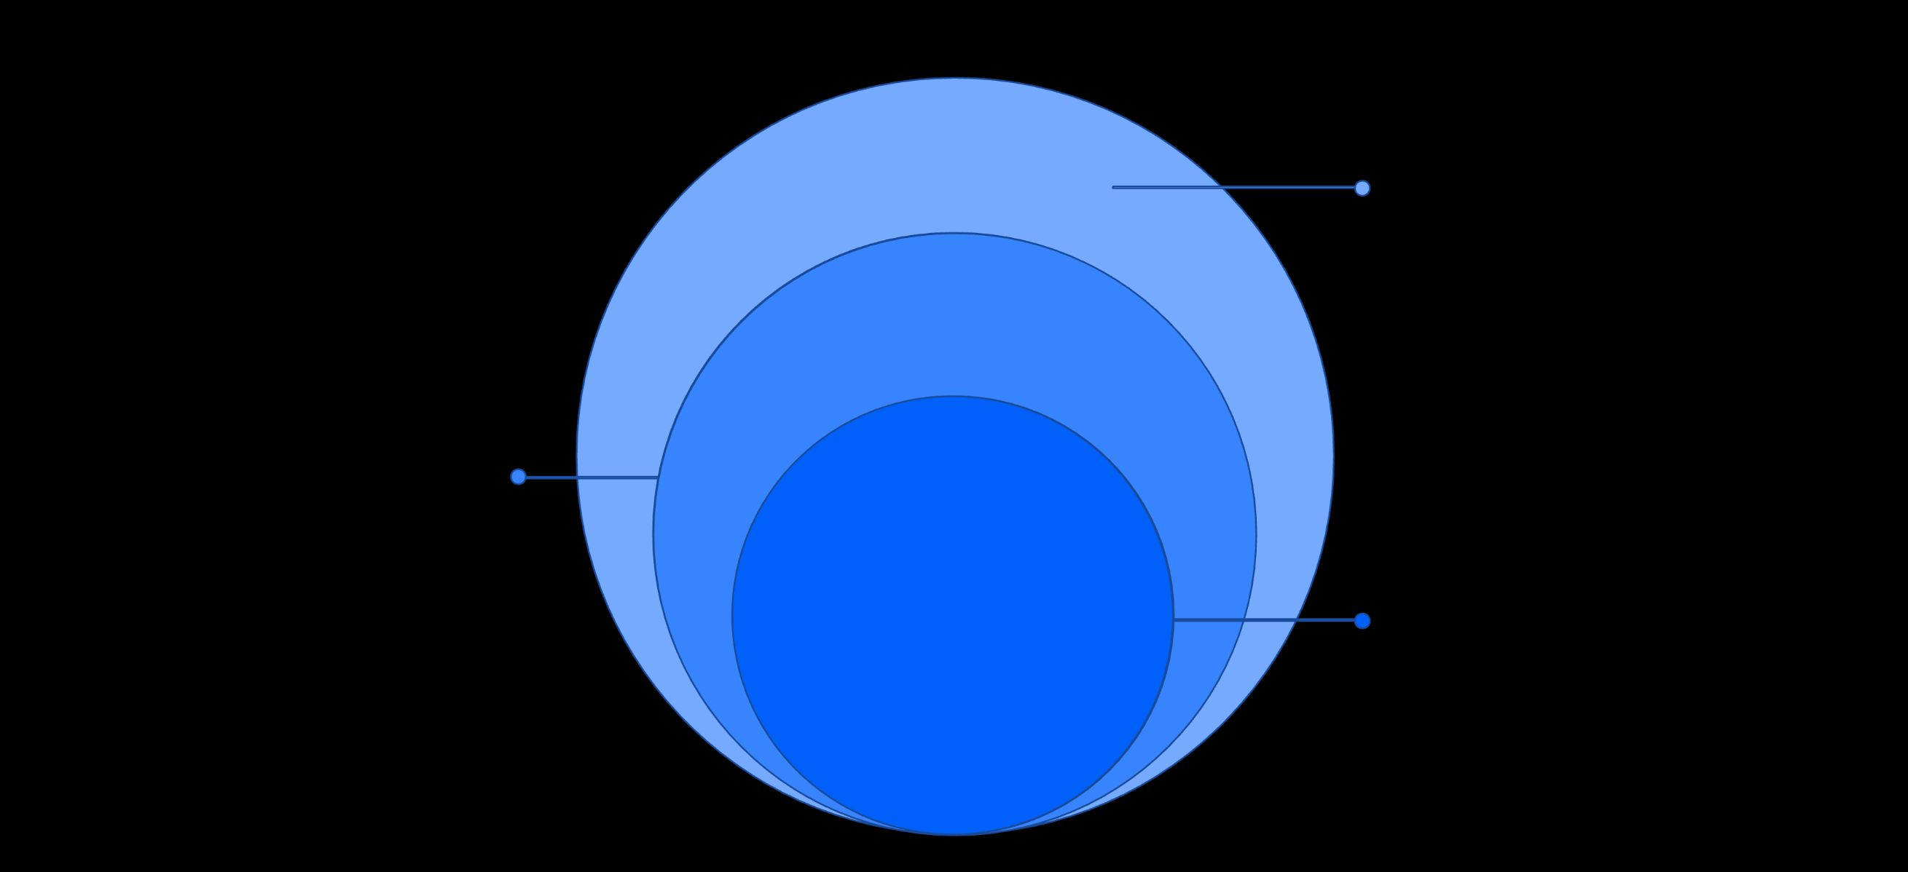
The AI Family Tree
Visualize the clear relationship: AI encompasses ML, and ML encompasses DL.
Artificial Intelligence
Systems that simulate human intelligence
Machine Learning
Algorithms that learn from data
Deep Learning
Neural networks with many layers
Each layer builds upon the last, leading to increasingly sophisticated capabilities.

Slide 6
AI in Action: Real-World Applications
AI is already making decisions and impacting our daily lives in countless ways.
Autonomous Vehicles
Smart Assistants
Navigating roads and making real-time driving decisions.
Understanding commands and managing schedules.
Healthcare Diagnostics
Fraud Detection
Assisting doctors in identifying diseases earlier.
Protecting your finances by identifying suspicious activities.

Slide 7

Personalized Experiences
AI tailors content, recommendations, and services just for you.
Shopping Recommendations
Helping you discover new products you'll love.
Streaming Suggestions
Curating movies and music based on your taste.
News Feeds
Presenting articles and updates relevant to your interests.

Slide 8

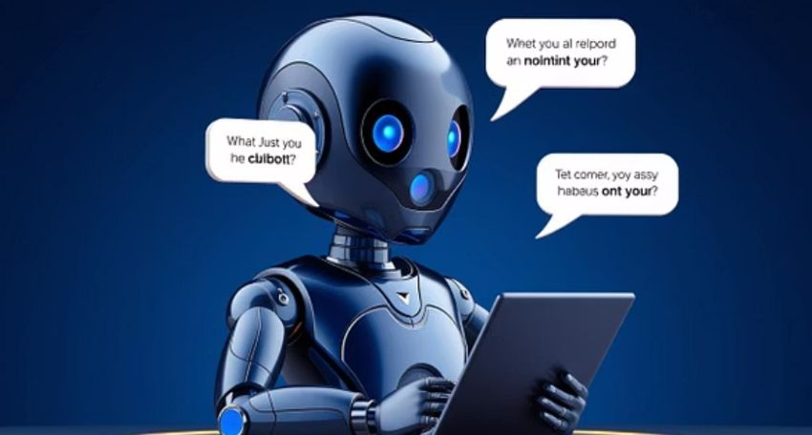
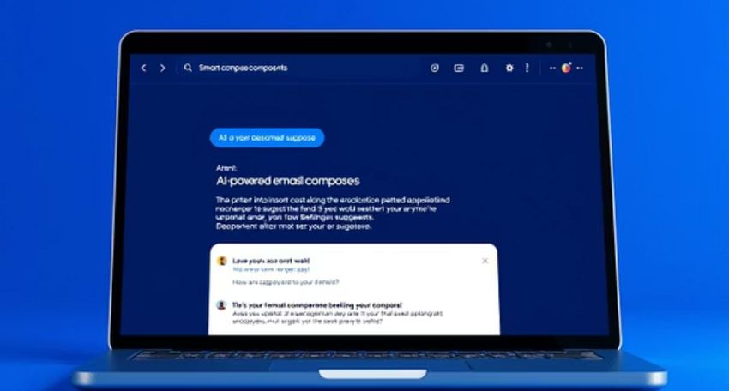
Enhancing Communication
AI breaks down barriers and makes interactions smoother and more efficient.
Real-time Translation
Smart Text Prediction
Intelligent Chatbots
Connecting people across different languages.
Helping us write faster and more accurately.
Providing instant support and information.

Slide 9
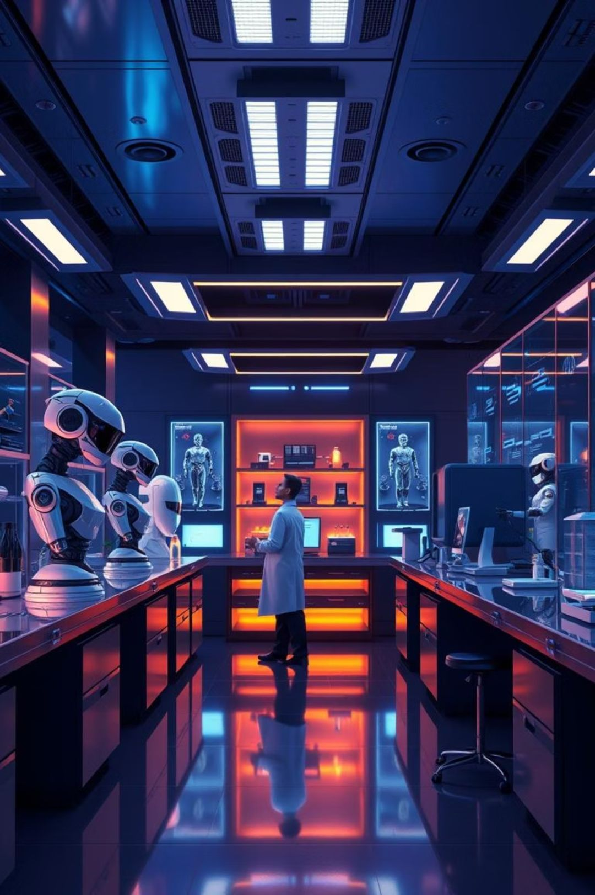
Shaping Our Future
AI is constantly evolving, promising even more innovative solutions ahead.
Unlocking New Discoveries
Optimizing Systems
Making industries and processes more efficient and sustainable.
Accelerating research in science, medicine, and engineering.
Inspiring Creativity
Providing tools for artists, designers, and innovators.

Slide 10
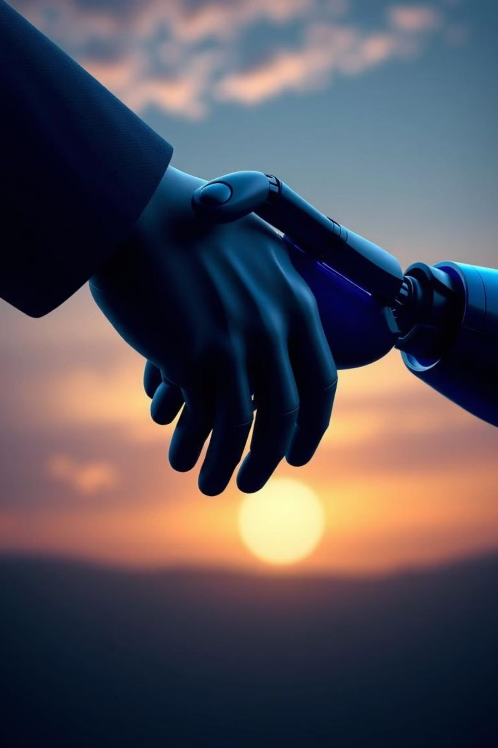
AI: Enhancing Human Decisions
It's not about replacing humans — it's about enhancing human decisions.
AI serves as a powerful partner, augmenting our capabilities and driving progress for a brighter tomorrow. Embrace the journey!

